Slide 1
BRAIN-A-LYTICS
Team Name: INNOVATION GEEKS Institute: IIM CALCUTTA
Participant’s names:
GIRISH DEV KUMAR CHAURASIYA
SUMAN PAL
SUGANDHA RANJAN

Slide 2
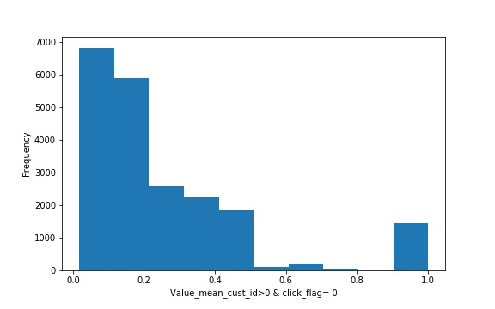
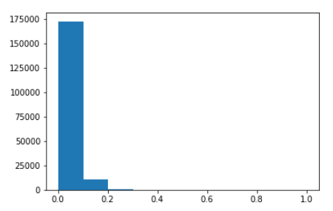
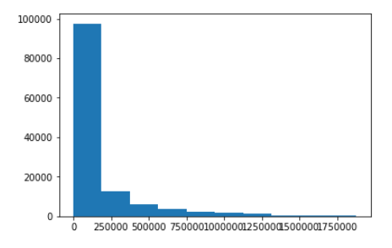
EDA analysis of a range of combinations of given attributes have been carried out in order to find out the relevance and significance of different variables in the dataset along with their correlation
Exploratory data analysis
value_mean_cust_id - Calculated the average number of actions which a customer clicked for a previous time. The above graph shows the distribution for click_flag=1 and below shows for click_flag=0.
Value_mean_app_code - The calculated average number of activities which users with this app_code clicked for previous time. The above graph shows distribution for click_flag=1 and below shows for click_flag=0
diff_time_cust_id_last - The time from the current impression time to the previous customer action. The above graph shows distribution for click_flag=1 and below shows for click_flag=0
The other similar combinations that have been tried out and compared are as follows:
Diff_time_cust_id_next - The time from the current impression time to the previous user action
diff time app code last-The time from the current impression time to the previous and next app code action for each app_code and impression_time
’diff time app code next-The time from the current impression time to the previous and next app code action for each app_code and impression_time

Slide 3
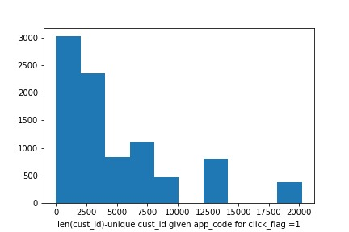
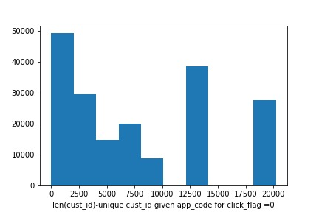
Exploratory data analysis
app_code: calculated the number of unique values from the user_id column. Calculated the difference and ratio between the number of unique values and the number of all values for app code id (’gg 2 diff’, ’gg 2 ratio’)
encoded the string values of the ‘os version‘ columns to integer values (category number)
From the column ‘impression time’, made two new features – ‘hour’ and ‘minute’
Cust_id -calculated the number of unique values from the column ‘app_code’(‘cnt unique app’). Calculated the difference and ratio between number of unique values and the number of all values for the user_id (’gg 1 diff’, ’gg 1 ratio’)
Number of activities in view log for previous time (’value cnt view user id’)
The mean, min, and max difference between two consecutive ‘server time’ in view log for previous time (’value diff time view user id ’value diff time view user id max’, ’value diff time view user id min’)

Slide 4
Analysis and Approach
FEATURE GENERATION – As per EDA, all the aforementioned combinations and expressions have been used as features: 'diff_time_mean', 'diff_time_max', 'diff_time_min', 'cnt_unique_app', 'hour', 'minute','vc_app_code', 'vc_cust_id', 'app_code_cnt_unique_user', 'value_mean_cust_id', 'diff_time_cust_id_last', 'value_mean_app_code', 'diff_time_app_code_last', 'diff_time_app_code_next', 'diff_time_cust_id_next', 'value_cnt_view_cust_id', 'cust_id_unique_session_id', 'cust_id_unique_item_id', 'cust_id_unique_product_type', 'value_diff_time_view_cust_id_mean', 'value_diff_time_view_cust_id_max', 'value_diff_time_view_cust_id_min', 'vc_cust_id_mode_item_id', 'vc_cust_id_mode_product_type', 'gg_1_diff', 'gg_1_ratio', 'gg_2_diff', 'gg_2_ratio‘
MODEL FITTING – We tried out two different tree based models:
RandomForest
Light Gradient Boosting Machine (LGBM)
But LGB resulted in better accuracy and hence been taken for our final consideration.
TUNING – model was tuned with following parameters:
bagging fraction = 0.8
bagging freq = 1
boost = gbdt
feature fraction = 0.8
learning rate = 0.01
metric = ‘AUC’
num leaves = 31
objective = binary
VALIDATION - StratifiedKFold with 10 folds, hence, we got10 models that were utilised to make predictions on the test data.. On local validation, following average AUC value was obtained: 0.74670.
Rank averaging among these 10 predictions was used as the final prediction

Slide 5
Validation methodology
Validation Methodology used – 10-fold stratified validation
Stopping Criteria – AUC score (iteration goes on until validation score doesn’t improve for 500 rounds)
ROC-AUC curve as indicated on the right, depicts the variability in true positive rate vs false positive rate with change in threshold value.
As area under curve for train data is 0.84, it is expected that test data would follow the same trend given that 10-fold cross validation is performed (prevents over-fitting)

Slide 6
Results from Modelling
Results
Test AUC – 74.67%
Threshold modified to improve true positive prediction -0.10925
F1-Score – 0.3455, Given the fact that data is highly imbalanced (4.5%) it is very difficult to get good F1 score. However above mentioned improvisation in the threshold has assisted us in achieving the same
Train Accuracy – 93%

Slide 7
Insights & Summary
 |  |  | cost benefit Analysis
cost per click | total clicks | conversion | CAC | LTV (3*CAC refer assumption) |  | total value added by customers (LTV * total conversions) |  |  | units
2000 | 197093 | 8969 | 43949.82718 | 131849.4815 |  | 1182558000 | based on train data |  | Rupees
 |  |  |  |  |  |  |  |  | CAC
 |  |  |  |  |  |  |  |  | cost of acquisition per customer
 |  |  | prediction
 |  |  |  |  |  |  | reference |  | LTV
cost per click | total clicks | conversion | total cost | total value added by customer (LTV*conversion number) | profit | true positve |  |  | life time value of cutomer
2000 | 3685 | 3685 | 7370000 | 485865339.5 | 478495339.5 | 3685 |  |  | assumptions
cost per click | total clicks | conversion | total cost |  |  | false positive | no cost incurred |  | LTV is assumed to be 3 times of average customer acquition cost
2000 | 5284 | 0 | 0 | 0 | 0
 |  |  |  |  |  |  |  |  | cost per click is assumed to be Rs 2000
cost per click | total clicks | conversion | total cost |  |  | false negative | no cost incurred
2000 | 179449 | 0 | 0 | 0 | 0 |  |  | 179449
cost per click | total clicks | conversion | total cost |  |  | false negative | cost incurred for wrongly predicted customers
2000 | 8674 | 8674 | 17348000 | 0 | -17348000
 |  |  |  | Value added by customers predicted using ML model | 461147339.5
 |  |  |  | % of total customer value predicted by ML | 38.99574816
Model is able to predict around 38% of total value generated on train data (Refer cost benefit analysis on the left)
Appropriate assumptions have been made with respect to the Cost of acquisition of customer and Life time value of customer.
The calculation is done on the train data however since the model is 10 fold cross validated it is unlikely that test data will show a huge variance from this value.

